Slide 1
Inventory Management System
Presented by :
Muhammad Danyal

Slide 2
Introduction
Inventory management is an essential process for businesses to organize, monitor, and control their stock efficiently. Managing inventory manually can lead to errors such as duplicate records, inaccurate stock calculations, and time-consuming operations. To solve these challenges, this Inventory Management System was developed in C++ using Object-Oriented Programming concepts. The system allows users to add, search, update, delete, and sort product records while also calculating the total inventory value. By automating these tasks, the project improves accuracy, saves time, and provides a structured way to manage inventory data effectively.

Slide 3
Problem Statement
Manual Records – Writing inventory by hand is slow and inefficient.
Duplicate Data – Same product can accidentally be entered multiple times.
Calculation Errors – Humans may miscalculate stock values and totals.

Slide 4
Project Objectives
Add Product – Allows user to insert a new product into inventory.
Search Product – Finds product quickly using product ID.
Update Product – Modifies quantity when stock changes.
Delete Product – Removes unavailable or discontinued products.
Sort Products – Organizes data for better readability.

Slide 5





System Capabilities
Data Management
Stores and organizes product records efficiently.
Time Efficiency
Reduces time spent on manual inventory tracking.
Accuracy Check
Ensures correct calculations and validation.
Quick Search
Provides fast product lookup by ID.
Smart Management
Supports better business decision-making.

Slide 6
Technologies Used
Project Structure
C++ – Main programming language used for project development.
OOP – Organizes code using classes and objects.
Vector Library – Stores products dynamically in memory.
Algorithm Library – Provides built-in sorting functions.
Product Class – Represents each individual product object.
InventoryManager Class – Handles all inventory operations.
Main Function – Starts execution of the entire program.

Slide 7
Product Class
Constructors
Product ID – Unique identifier assigned to each product.
Product Name – Stores name of the inventory item.
Quantity – Maintains available stock amount.
Unit Price – Stores price of one product unit.
Default Constructor – Initializes empty product values initially.
Parameterized Constructor – Creates object with user-provided values.

Slide 8
Getter Functions
Setter Function
getId() – Returns product ID safely.
getName() – Returns product name when required.
getQuantity() – Provides available stock amount.
getPrice() – Returns unit price value.
setQuantity() – Updates stock quantity securely.

Slide 9
InventoryManager Class
Add Product
vector<Product> – Stores all product objects dynamically.
Operations Control – Manages system functionalities centrally.
Validation Check – Prevents duplicate product IDs.
User Input – Takes product details from user.
Insertion – Adds product into vector.

Slide 10
Search Product
Update Product
ID Search – Finds product using unique ID.
Quick Access – Reduces time in locating items.
Stock Modification – Changes quantity after restocking.
Inventory Accuracy – Keeps stock values updated.

Slide 11
Delete Product
Sorting Functions
Remove Item – Deletes unwanted product records.
Memory Management – Frees vector space.
sortByName() – Sorts products alphabetically.
sortByPrice() – Sorts products by ascending price.

Slide 12
Total Inventory Value
Menu System
calculateTotalInventoryValue() – Computes sum of all products.
Business Insight – Shows complete stock worth.
User Interface – Displays all available operations.
Navigation – Helps user choose required action.

Slide 13
run() Function
Main Function
do-while Loop – Keeps program running continuously.
switch-case – Executes selected menu option.
Object Creation – Creates InventoryManager object.
Program Start – Calls run() to launch system.

Slide 14
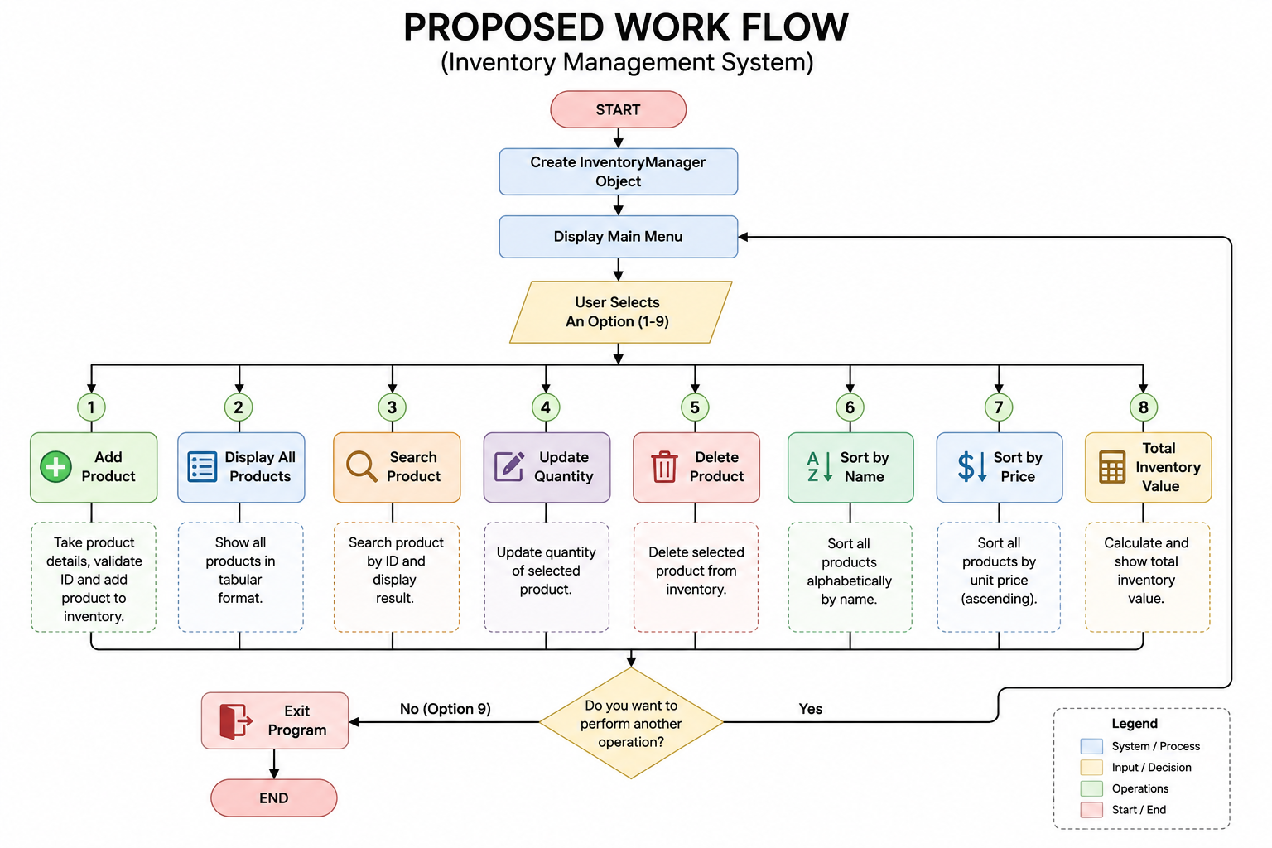
Proposed Work Flow

Slide 15
Conclusion
Successful Automation: The system successfully automates inventory operations and reduces manual work.
Efficient Product Management: Users can easily add, search, update, delete, and sort products.
Error Reduction: Automated calculations help minimize human mistakes in stock management.
OOP Implementation: The project demonstrates practical use of classes, objects and encapsulation in C++.
User-Friendly Design: Simple menu-based interface makes the system easy to operate.
Scalable Project: The system can be enhanced further with database, GUI, and file handling features.
Learning Outcome: This project improved understanding of C++ programming and real-world problem solving.

Slide 16
Thank You

